Slide 1

Function and Method

Slide 2
Outline
Function and Method
Method definition
Project
Interview Questions
Summary

Slide 3
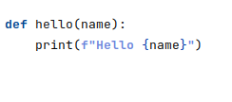
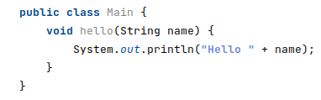
Function and Method
A function is a set of instructions or procedures to perform a specific task, and a method is a set of instructions that are associated with an object.

Slide 4
Method definition
public int add(int x, int y)
method declaration (header)
  Access modifier
  Return type
  Method name
  Input parameters
method body
{
int result = x + y;
return result;
}

Slide 5
Guess Game with methods

Slide 6
Interview Questions

Slide 7
“People who say it cannot be done should not interrupt those who are doing it”

